Slide 1
TrawlExpert
A Tool for Environmental Scientific Research
Chris Schankula

Slide 2
Declining Fish Populations
Source: Great Lakes Fishery Commission, http://www.glfc.org/eforum/article7.html

Slide 3
Trawl Surveys
Trawling: method of fishing along bottom using nets
Used to estimate relative fish population, births, deaths, etc. over time
USGS dataset from 1958-2016 contains over 283,000 records

Slide 4
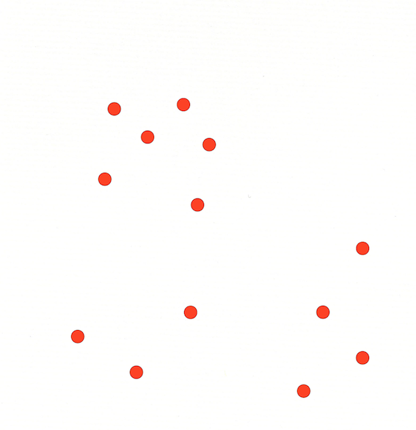
TrawlExpert
Intelligent domain-specific tools for researchers for extracting relevant data, generating statistics

Slide 5
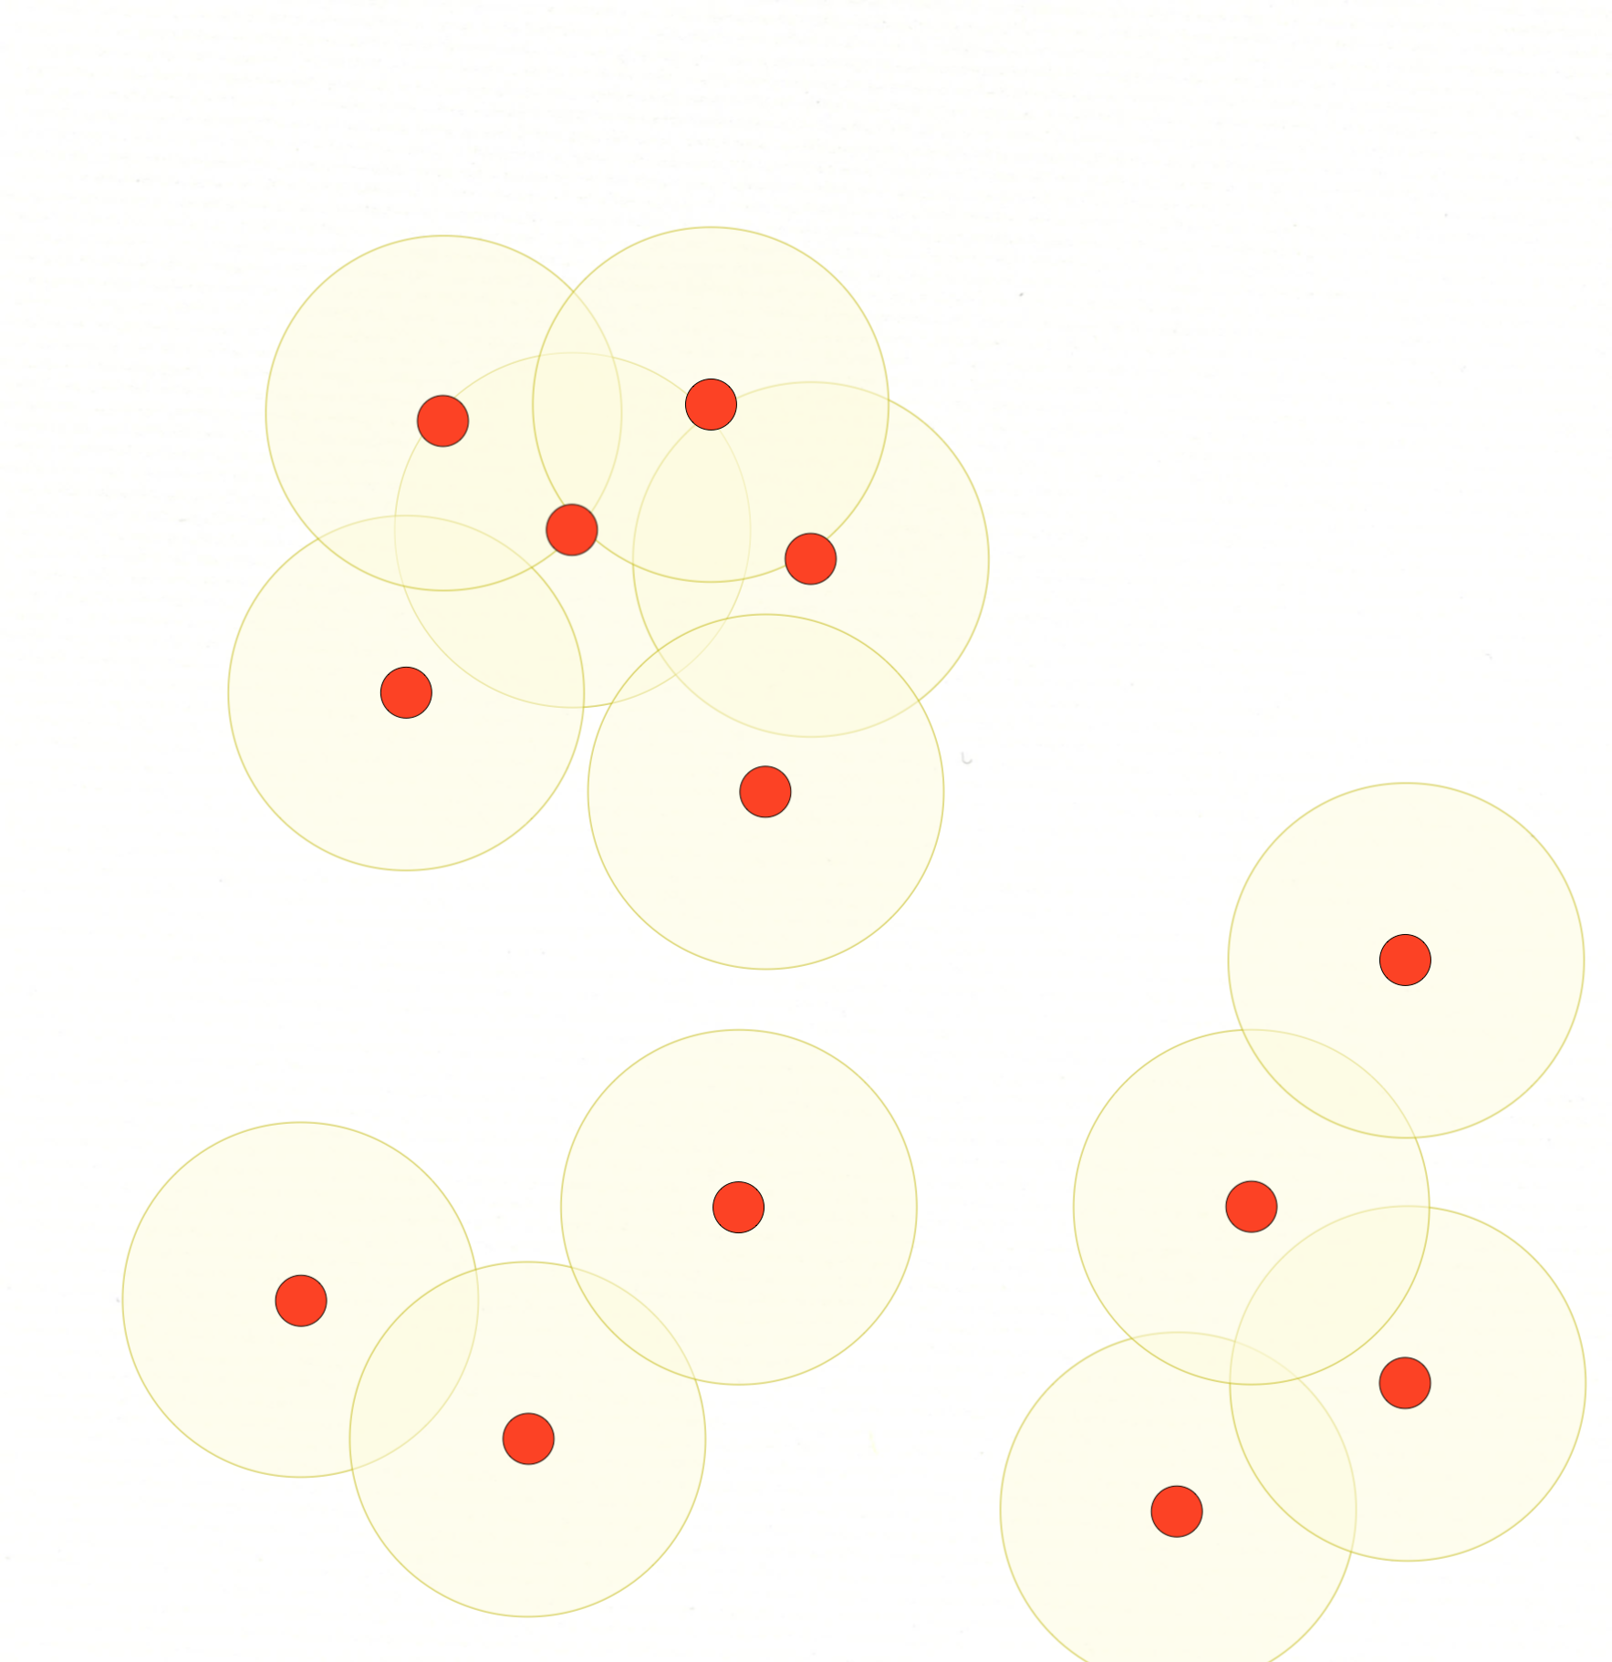
TrawlExpert
Intelligent domain-specific tools for researchers for extracting relevant data, generating statistics

Slide 6
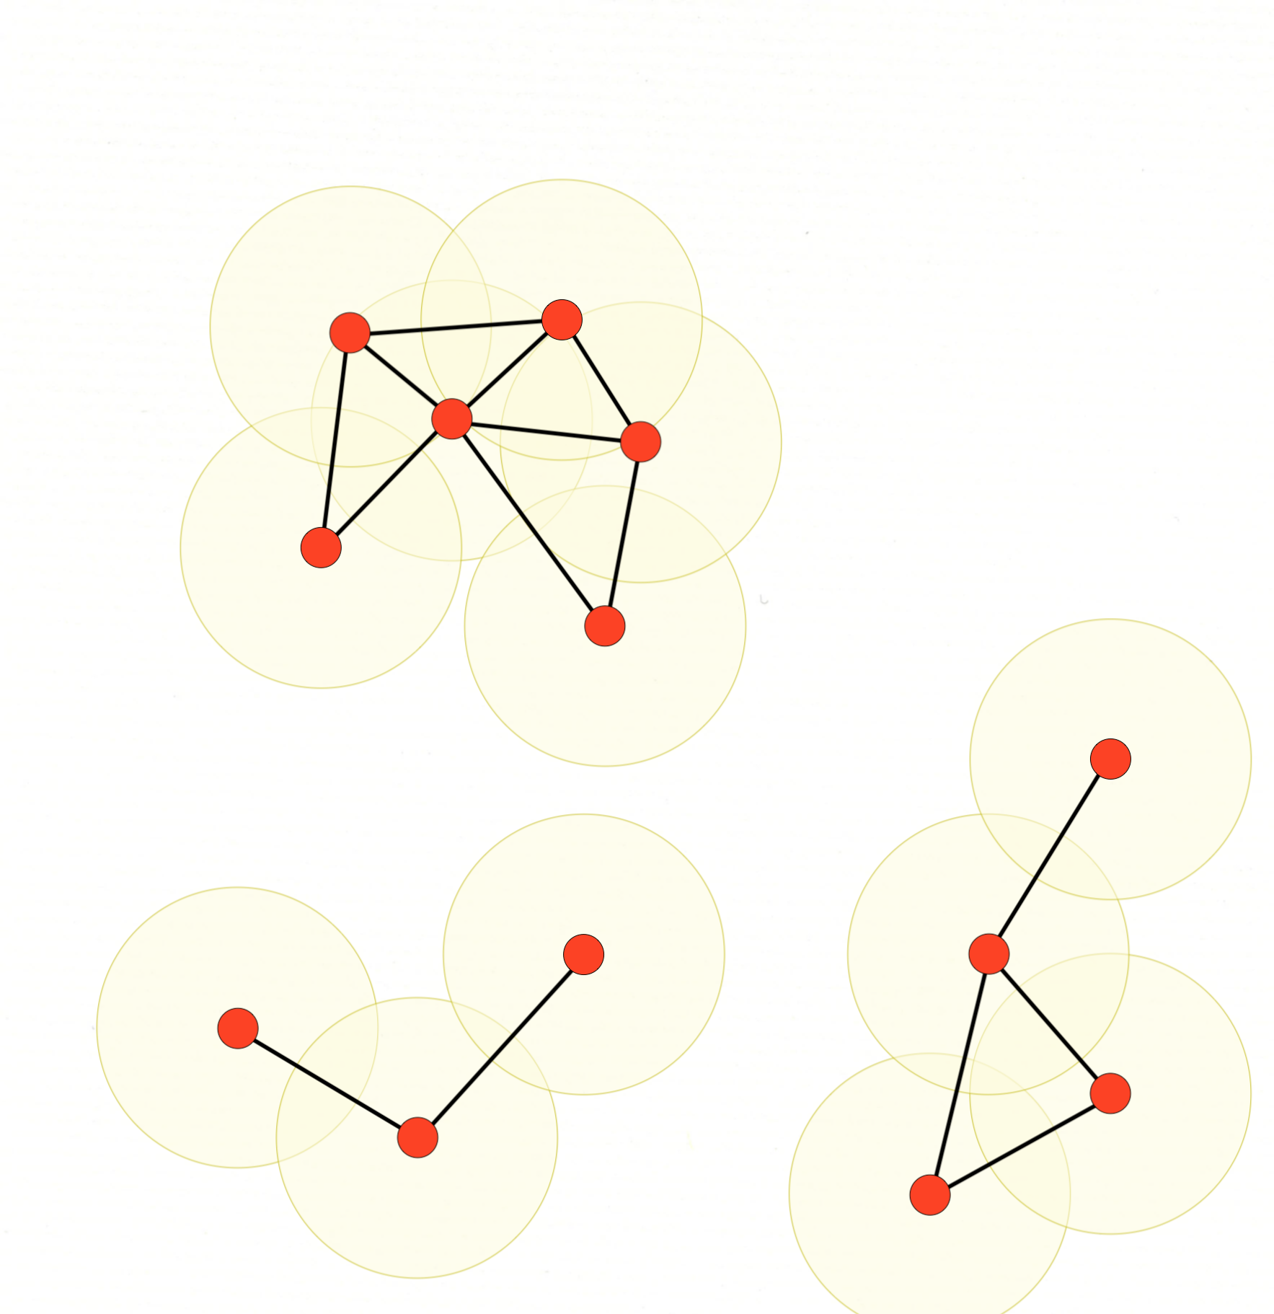
TrawlExpert
Intelligent domain-specific tools for researchers for extracting relevant data, generating statistics

Slide 7
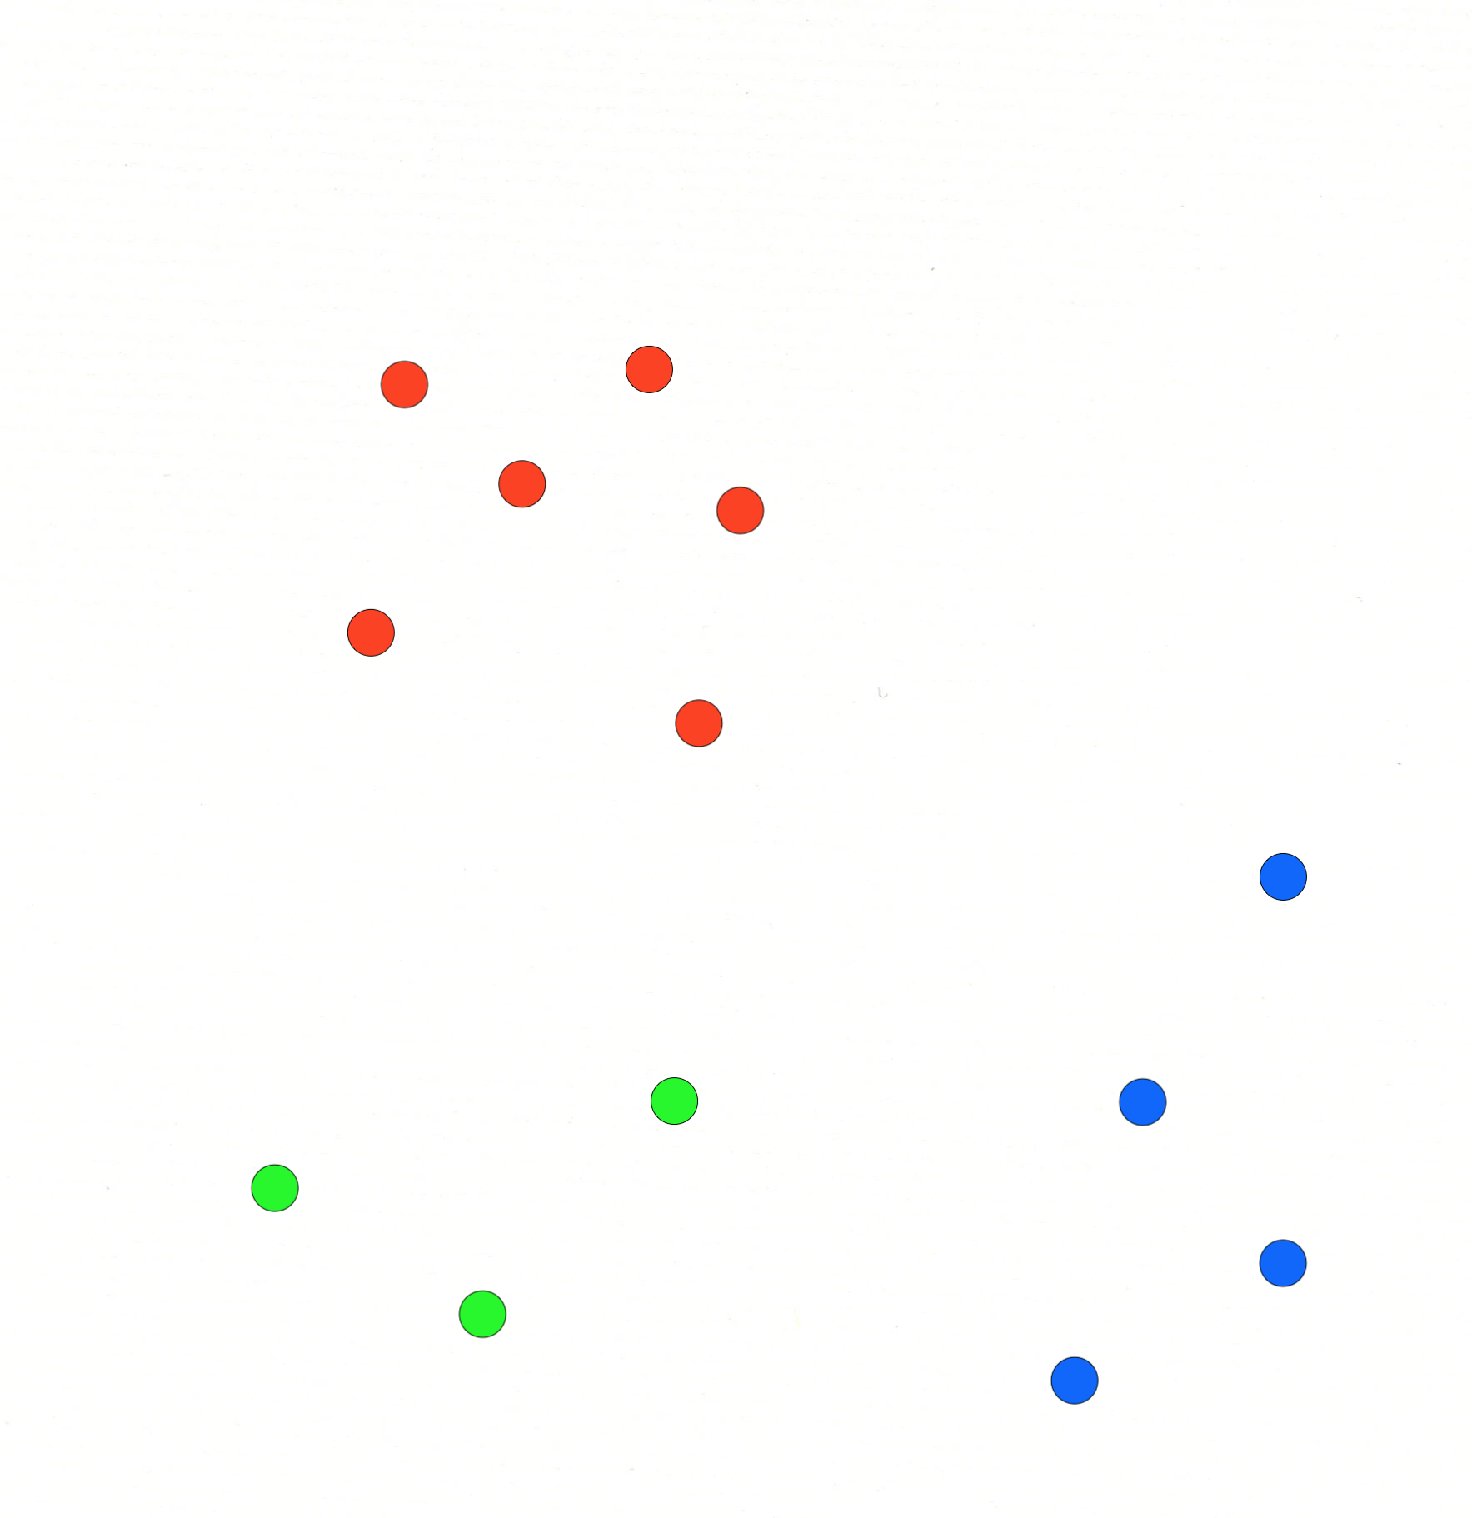
TrawlExpert
Intelligent tools for extracting and classifying relevant data

